Slide 1

FoodRescue AI – Smart Food Redistribution Using Markov Decision process and Bellman Equations
Presented by : Galla Sai Siddartha (192425093)
: Shaik Ahamed Ali (192425106)
: A.Surendra krishna (192472202)
: M.Harinath (192425020)
: P.Vishnu vardhan (192425212)
Subject code : MLA0302
Subject : Reinforcement Learning
Guide name : Dr.T.P.Anithaashri

Slide 2


ABSTRACT
FoodRescue AI is an intelligent food redistribution system designed to reduce food wastage by connecting food donors with suitable NGOs.
The project uses Reinforcement Learning (RL) as the core decision-making mechanism to determine the best NGO for each available food donation.
The system considers multiple factors such as food expiry time, distance between donor and NGO, NGO food demand, available quantity, and previous delivery success.
A Markov Decision Process (MDP) is used to model the food redistribution environment, where the system observes the current state and selects appropriate actions.
Bellman Equations and Q-Learning are used to evaluate and improve the decision-making policy based on rewards received from successful food redistribution.

Slide 3
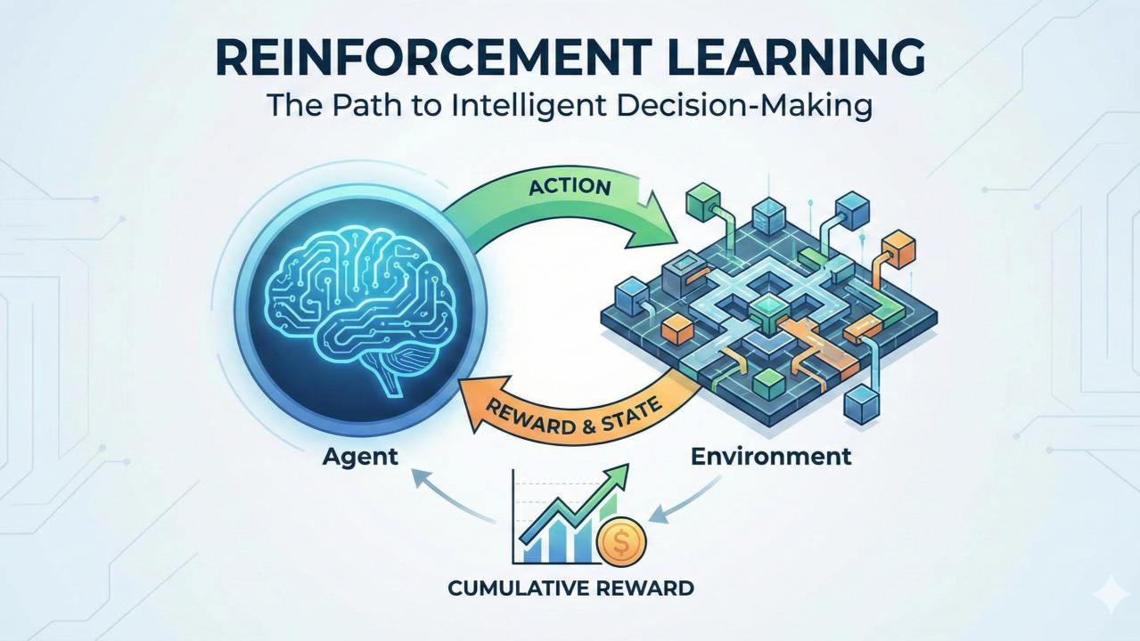
INTRODUCTION
Food wastage is a major problem despite increasing food insecurity.
Surplus food can be redistributed to NGOs instead of being wasted.
Selecting the right NGO depends on time, distance, demand, and food quantity.
FoodRescue AI uses AI to make smart food redistribution decisions.
Reinforcement Learning helps the system learn from previous donation outcomes.
A Markov Decision Process (MDP) models the food redistribution environment.

Slide 4
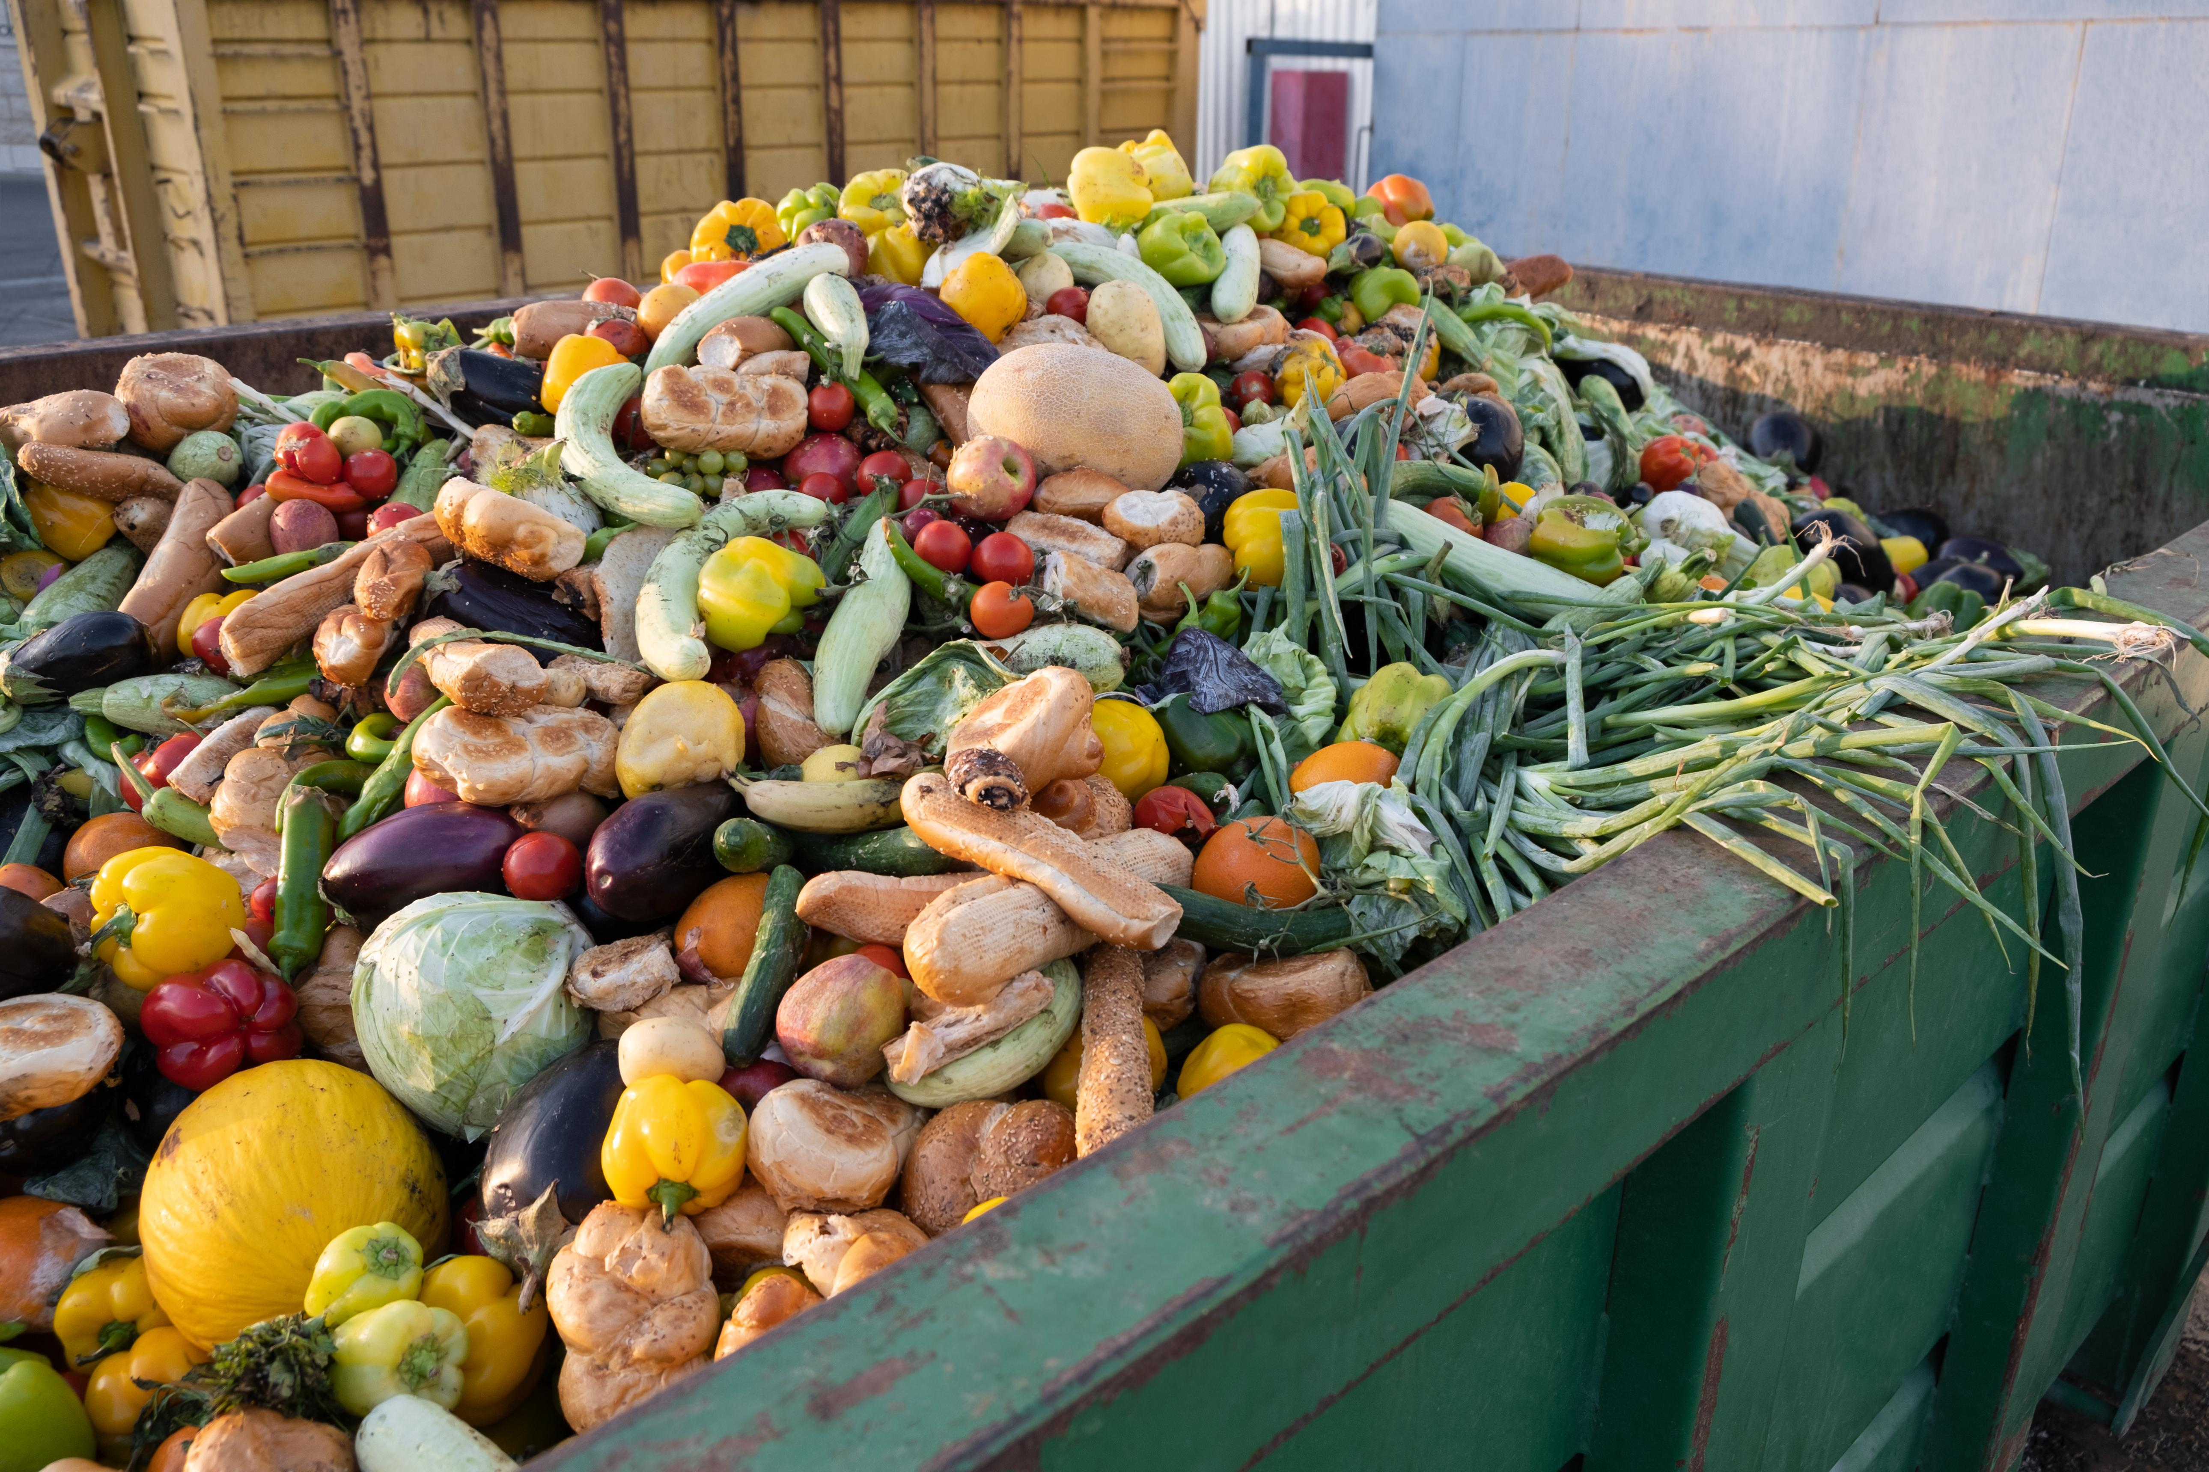
PROBLEM STATEMENT
Large amounts of surplus edible food are wasted every day.
NGOs often struggle to receive the right quantity of food at the right time.
Manual NGO selection may lead to delays and inefficient food distribution.
Food expiry time makes quick and accurate decision-making essential.
Multiple factors such as distance, demand, and delivery success must be considered.
Traditional systems do not learn from previous donation and delivery outcomes.

Slide 5
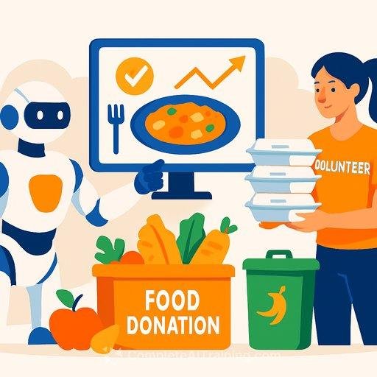
OBJECTIVE
To reduce food wastage by enabling efficient redistribution of surplus food.
To identify and select the most suitable NGO for each food donation.
To use Reinforcement Learning and Q-Learning for intelligent decision-making.
To consider factors such as food expiry time, distance, NGO demand, and delivery success.
To predict NGO food requirements using the K-Nearest Neighbors (KNN) algorithm.

Slide 6
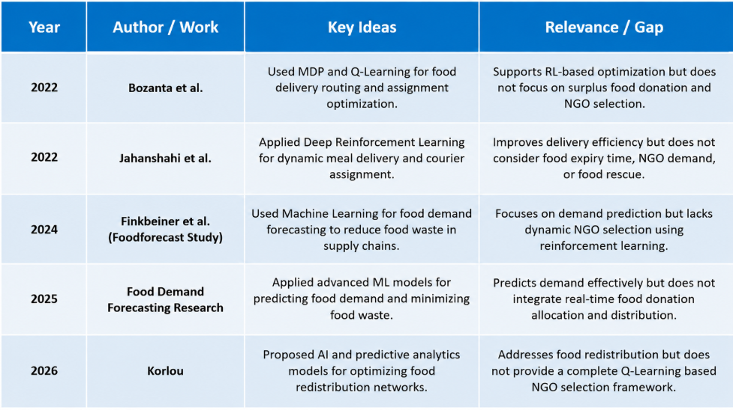
LITERATURE REVIEW

Slide 7
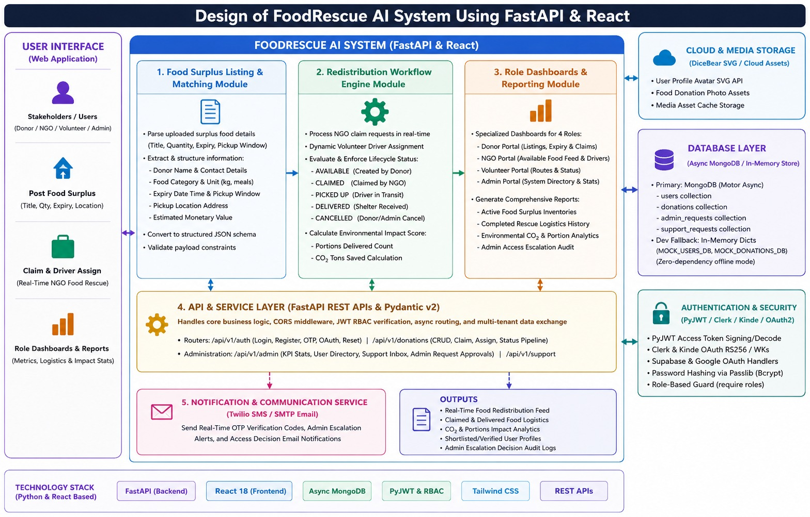
ARCHITECTURE DIAGRAM

Slide 8
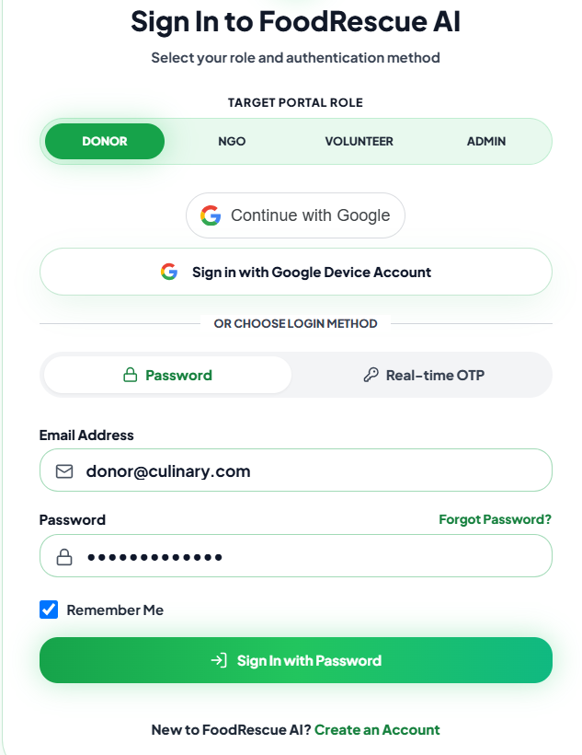
Module 1 : User Authentication and Data Management using JWT
Secure user registration and login using Google Authentication.
Real-time OTP verification using Twilio for secure user validation.
Google OAuth Algorithm – Used for secure login through Google authentication.
OTP Verification Algorithm – Generates and verifies a one-time password.
Technologies Used:
Google Authentication | Twilio OTP | Supabase | JWT

Slide 9
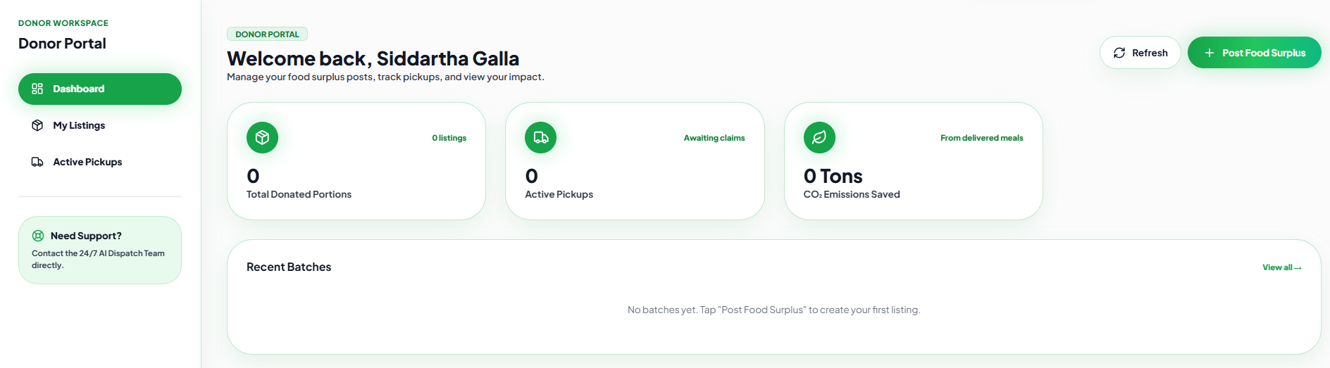
Module 2 : Food Donation Processing using Rule-Based Validation
Enables users to submit surplus food donation details through the system.
Collects information such as food type, quantity, preparation time, expiry time,location.
Algorithm Used: Rule-Based Validation Algorithm
Uses predefined IF–ELSE rules to validate food donation details.
Checks food expiry time, quantity, food type, and required information.

Slide 10
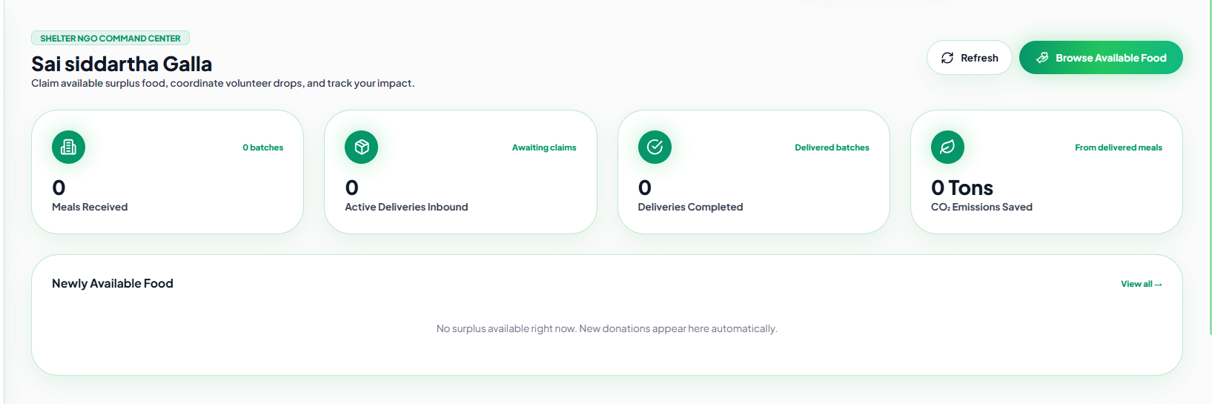
Module 3 : NGO Demand Prediction using K-Nearest Neighbors (KNN)
Predicts the food demand of NGOs based on historical donation and requirement data.
Uses K-Nearest Neighbors (KNN) to identify NGOs with similar past demand patterns.
Considers factors such as food type, quantity required, location, and number of Beneficiaries.
Identifies NGOs with high or urgent food requirements.

Slide 11
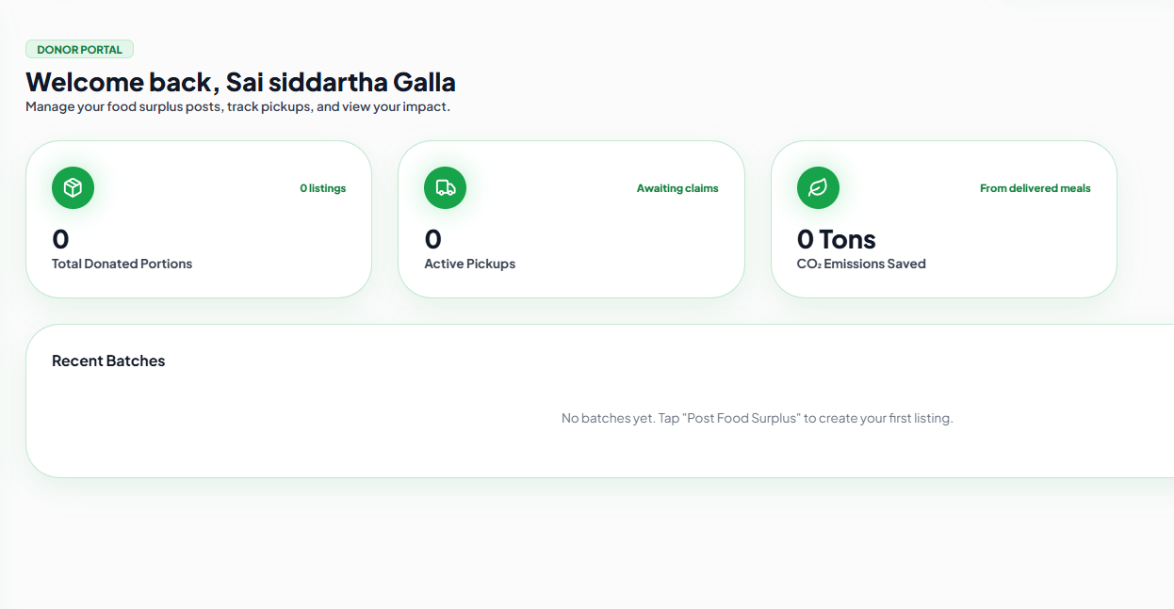
Module 4 : Smart NGO Selection using Q-Learning
This module displays candidate rankings and recruitment information through an interactive dashboard.
The system generates recruitment reports, candidate summaries, and hiring statistics automatically.
Algorithm Used: Q-Learning Algorithm
Models the system using a Markov Decision Process (MDP).
Considers NGO selection as an action based on the current state.

Slide 12
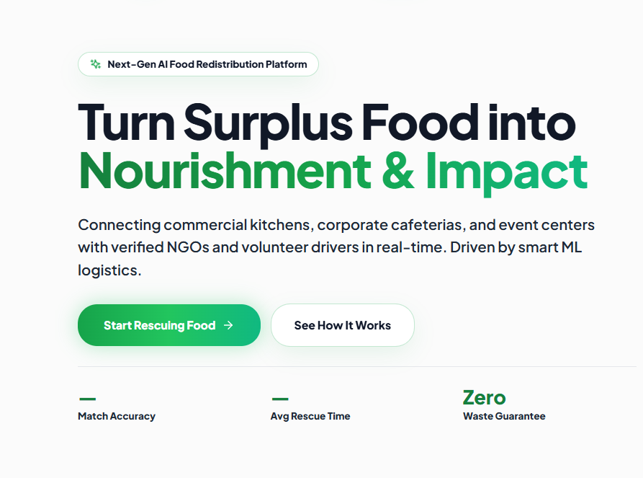
Module 5 : Dashboard Analytics and Performance Evaluation
Provides a centralized dashboard to monitor food donations, NGO requests, and delivery activities.
Displays real-time statistics such as total donations, successful deliveries, pending requests, and food saved.
Tracks the performance of the KNN demand prediction model and Q-Learning NGO selection process.
Analyzes important metrics such as delivery success rate, average delivery time, reward values, and NGO selection accuracy.

Slide 13
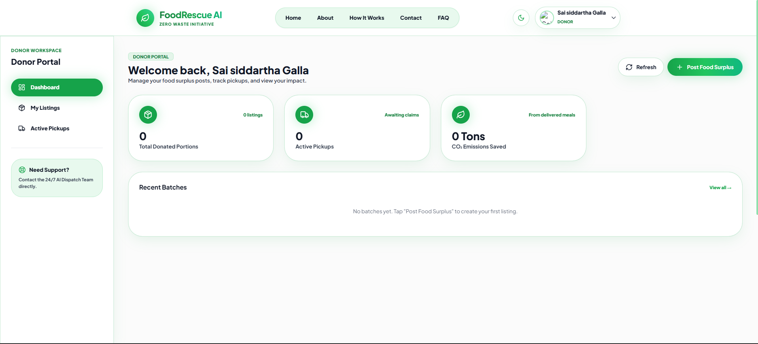
IMPLEMENTATION

Slide 14

TOOLS & TECHNOLOGIES
React.js & Node.js –
Frontend and backend development.
Supabase –
Database, authentication, and real-time data management.
Google Authentication & Twilio OTP –
Secure user authentication and verification.
Python & Scikit-learn –
Implementation of KNN demand prediction.
Q-Learning, MDP & Bellman Equation –
Smart NGO selection and decision-making.
GitHub, VS Code & Postman –
Development, version control, and API testing.

Slide 15
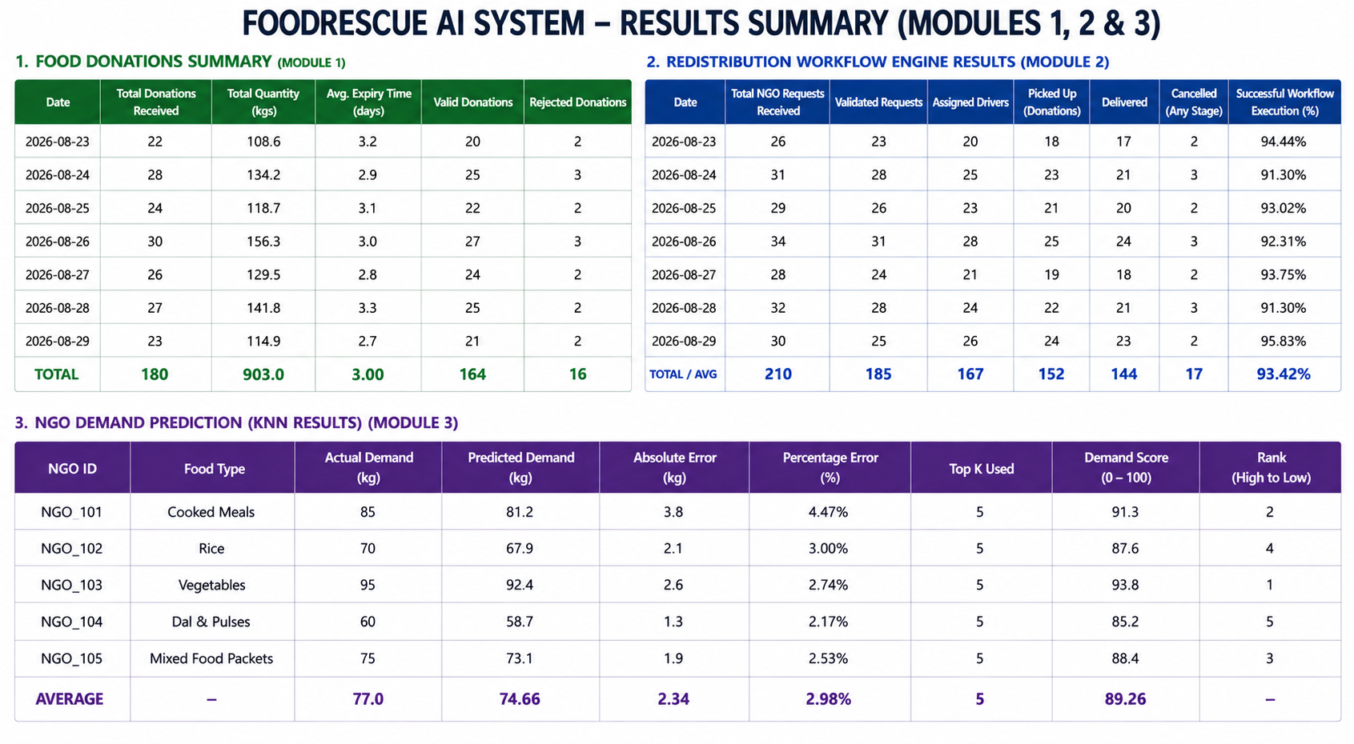
RESULTS

Slide 16
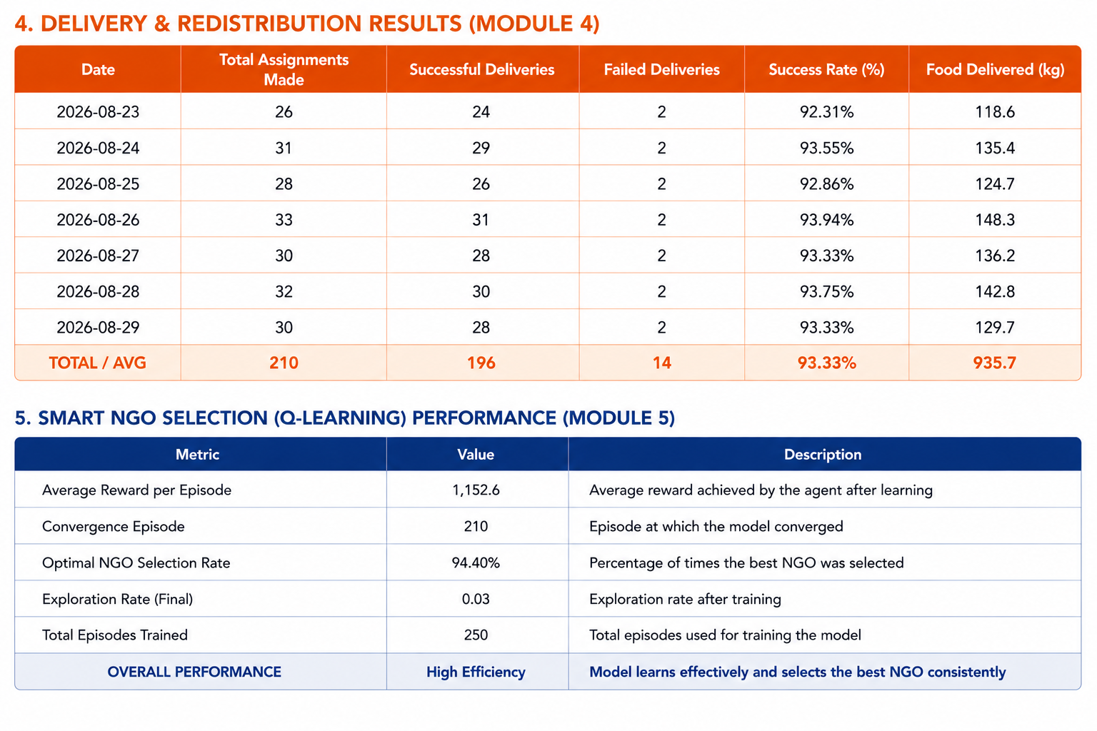
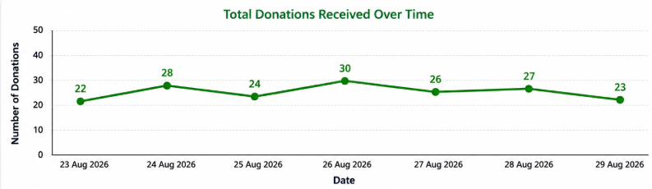
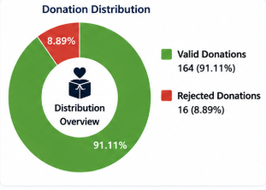
RESULTS

Slide 17
FUTURE ENHANCEMENTS
Real-Time Route Optimization – Optimize delivery routes based on traffic, distance, and food expiry time.
IoT-Based Food Monitoring – Use sensors to track food temperature and freshness during transportation.
Advanced AI Models – Integrate Deep Reinforcement Learning for more complex and scalable decision-making.
Blockchain Integration – Improve transparency and traceability of food donations and deliveries.
Mobile Application – Develop a dedicated mobile app for donors, NGOs, and delivery volunteers.
Multi-City Expansion – Scale the system to connect multiple cities and larger food redistribution networks.

Slide 18
CONCLUSION
FoodRescue AI provides an intelligent solution for reducing food wastage through efficient food redistribution.
The system combines KNN demand prediction and Q-Learning for smarter NGO selection.
Factors such as food expiry time, distance, demand, and delivery success are considered for decision-making.
MDP and Bellman Equations enable the system to learn and improve from previous outcomes.
Secure authentication, real-time data management, and analytics improve the overall system functionality.
Overall, the project aims to ensure that surplus food reaches the right NGO at the right time, reducing waste and supporting communities in need.

Slide 19
REFERENCES
Richard S. Sutton and Andrew G. Barto, “Reinforcement Learning: An Introduction,” MIT Press, 2nd Edition, 2018.
Christopher J. C. H. Watkins and Peter Dayan, “Q-Learning,” Machine Learning, Vol. 8, pp. 279–292, 1992.
Richard Bellman, “A Markovian Decision Process,” Journal of Mathematics and Mechanics, Vol. 6, No. 5, pp. 679–684, 1957.
Thomas Cover and Peter Hart, “Nearest Neighbor Pattern Classification,” IEEE Transactions on Information Theory, Vol. 13, No. 1, pp. 21–27, 1967.
Stefan Minner and Christian M. J. Tam, “Food Waste Reduction Through Intelligent Supply Chain and Redistribution Systems,” International Journal of Production Economics.

Slide 20


